Slide 1

Chapter 10
Error Detection
and
Correction
10.<number>

Slide 2

Note
Data can be corrupted
during transmission.
Some applications require that
errors be detected and corrected.
Some applications can tolerate a small level of error. For example, random errors in audio or video transmissions may be tolerable, but when we transfer text, we expect a very high level of accuracy.
10.<number>

Slide 3
10-1 INTRODUCTION
Let us first discuss some issues related, directly or indirectly, to error detection and correction.
Topics discussed in this section:
Types of Errors
Redundancy
Detection Versus Correction
Forward Error Correction Versus Retransmission
Coding
Modular Arithmetic
10.<number>

Slide 4
Note
In a single-bit error, only 1 bit in the data unit has changed.
Single-bit errors are the least likely type of error in serial data transmission. To understand why, imagine data sent at 1 Mbps. This means that each bit lasts only 1/1,000,000 s, or 1µs. For a single-bit error to occur, the noise must have a duration of only 1µs, which is very rare; noise normally lasts much longer than this.
10.<number>

Slide 5

Figure 10.1 Single-bit error
American Standard Code for Information Interchange = ASCII
It's a 7-bit character code where every single bit represents a unique character.
2⁷=128
ASCII code: 0-127
2:STX=start of text
10: LF= line feed
10.<number>

Slide 6
Note
A burst error means that 2 or more bits in the data unit have changed.
A burst error does not necessarily mean that the errors occur in consecutive bits. The length of the burst is measured from the first corrupted bit to the last corrupted bit. Some bits in between may not have been corrupted.
10.<number>

Slide 7

Figure 10.2 Burst error of length 8
The number of bits affected depends on the data rate and duration of noise. For example, if we are sending data at 1 kbps, a noise of 0.01 s can affect 10 bits(=1000×0.01); if we are sending data at 1 Mbps, the same noise can affect 10,000 bits(=1000000×0.01).
10.<number>

Slide 8

Detection Versus Correction
The correction of errors is more difficult than the detection.
In error detection, we are looking only to see if any error has occurred. The answer is a simple yes or no. We are not even interested in the number of errors. A single-bit error is the same for us as a burst error.
In error correction, we need to know the exact number of bits that are corrupted and more importantly, their location in the message. The number of the errors and the size of the message are important factors.
If we need to correct one single error in an 8-bit data unit, we need to consider 8 possible error locations. (⁸C₁)
If we need to correct two errors in a data unit of the same size, we need to consider 28 possibilities. (⁸C₂)
You can imagine the receiver's difficulty in finding 10 errors in a data unit of 1000 bits.
(¹⁰⁰⁰C₁₀)=263409560461970212832400 possibilities
10.<number>

Slide 9
Redundancy
To detect or correct errors, we need to send extra (redundant) bits with data.
These redundant bits are added by the sender and removed by the receiver. Their presence allows the receiver to detect or correct corrupted bits.
Redundancy is achieved through various coding schemes. The sender adds redundant bits through a process that creates a relationship between the redundant bits and the actual data bits. The receiver checks the relationships between the two sets of bits to detect or correct the errors. Figure 10.3 shows the general idea of coding.
10.<number>

Slide 10

Figure 10.3 The structure of encoder and decoder
10.<number>

Slide 11
Modular Arithmetic
In modulo-N arithmetic, we use only the integers in the range 0 to N −1, inclusive.
Inclusive - Including the last number, Exclusive - Excluding the last number
e.g., [1,10]=1 2 3…10 is inclusive and [1,10)=1 2 3…9 is exclusive
For example, if the modulus is 12, we use only the integers 0 to 11, inclusive. An example of modulo arithmetic is our clock system. It is based on modulo-12 arithmetic, substituting the number 12 for 0.
In a modulo-N system, if a number is greater than N, it is divided by N and the remainder is the result. If it is negative, as many Ns as needed are added to make it positive.
Consider our clock system again. If we start a job at 11 A.M. and the job takes 5 h, we can say that the job is to be finished at 16:00 if we are in the military, or we can say that it will be finished at 4 P.M. (the remainder of 16/12 is 4).
10.<number>

Slide 12

Modulo-2 Arithmetic: N=2
If we get a negative result, we add enough multiples of N to make it positive.
Addition: 0+0=0, 0+1=1, 1+0=1, 1+1=0
Subtraction: 0-0=0, 0-1=1, 1-0=1, 1-1=0
[-1+2=1]
Figure 10.4 XORing of two single bits or two words
10.<number>

Slide 13
10-2 BLOCK CODING
In block coding, we divide our message into blocks, each of k bits, called datawords. We add r redundant bits to each block to make the length n = k + r. The resulting n-bit blocks are called codewords.
Topics discussed in this section:
Error Detection
Error Correction
Hamming Distance
Minimum Hamming Distance
10.<number>

Slide 14

Figure 10.5 Datawords and codewords in block coding
Since n > k, the number of possible codewords is larger than the number of possible datawords. The block coding process is one-to-one; the same dataword is always encoded as the same codeword. This means that we have 2^{n} - 2^{k} codewords that are not used. We
call these codewords invalid or illegal.
10.<number>

Slide 15
Error Detection
How can errors be detected by using block coding?
If the following two conditions are met, the receiver can detect a change in the original codeword.
1. The receiver has (or can find) a list of valid codewords.
2. The original codeword has changed to an invalid one.
The sender creates codewords out of datawords by using a generator that applies the rules and procedures of encoding.
Each codeword sent to the receiver may change during transmission. If the received codeword is the same as one of the valid codewords, the word is accepted; the corresponding dataword is extracted for use.
If the received codeword is not valid, it is discarded. However, if the codeword is corrupted during transmission but the received word still matches a valid codeword, the error remains undetected.
This type of coding can detect only single errors. Two or more errors may remain undetected.
10.<number>

Slide 16

Figure 10.6 Process of error detection in block coding
10.<number>

Slide 17
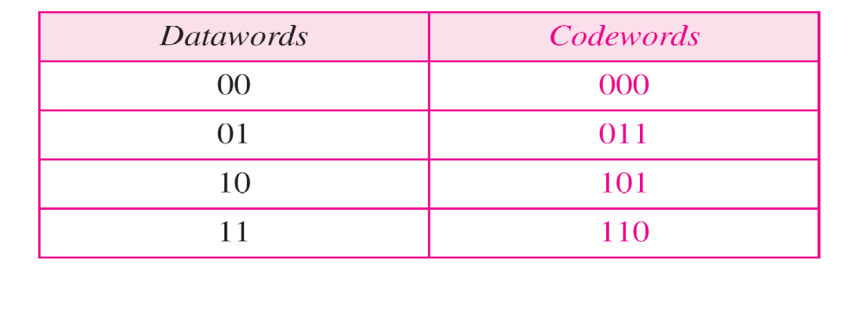
Example 10.2
Table 10.1 A code for error detection (Example 10.2)
Let us assume that k = 2 and n = 3. Table 10.1 shows the list of datawords and codewords. Later, we will see how to derive a codeword from a dataword.
Assume the sender encodes the dataword 01 as 011 and
sends it to the receiver. Consider the following cases:
1. The receiver receives 011. It is a valid codeword. The
receiver extracts the dataword 01 from it.
011→011
10.<number>

Slide 18
Example 10.2 (continued)
011→111
2. The codeword is corrupted during transmission, and
111 is received. This is not a valid codeword and is
discarded.
3. The codeword is corrupted during transmission, and
000 is received. This is a valid codeword. The receiver
incorrectly extracts the dataword 00. Two corrupted
bits have made the error undetectable.
011→000
10.<number>

Slide 19
Note
An error-detecting code can detect
only the types of errors for which it is designed; other types of errors may remain undetected.
10.<number>

Slide 20
Error Correction
As we said before, error correction is much more difficult than error detection.
In error detection, the receiver needs to know only that the received codeword is invalid; in error correction the receiver needs to find (or guess) the original codeword sent.
We can say that we need more redundant bits for error correction than for error detection.
Figure 10.7 shows the role of block coding in error correction. The idea is the same as error detection but the checker functions are much more complex.
10.<number>

Slide 21

Figure 10.7 Structure of encoder and decoder in error correction
10.<number>

Slide 22

Example 10.3
Let us add more redundant bits to Example 10.2 to see if the receiver can correct an error without knowing what was actually sent. We add 3 redundant bits to the 2-bit dataword to make 5-bit codewords. Table 10.2 shows the datawords and codewords. Assume the dataword is 01. The sender creates the codeword 01011. The codeword is corrupted during transmission, and 01001 is received. First, the receiver finds that the received codeword is not in the table. This means an error has occurred. The receiver, assuming that there is only 1 bit corrupted, uses the following strategy to guess the correct dataword.
Table 10.2 A code for error correction (Example 10.3)
10.<number>

Slide 23
Example 10.3 (continued)
Comparing the received codeword with the first codeword in the table (01001 versus 00000), the receiver decides that the first codeword is not the one that was sent because there are two different bits.
By the same reasoning, the original codeword cannot be the third or fourth one in the table.
3. The original codeword must be the second one in the table because this is the only one that differs from the received codeword by 1 bit. The receiver replaces 01001 with 01011 and consults the table to find the dataword 01.
01001
01001
01001
01001
10.<number>

Slide 24
Hamming Distance
The Hamming distance between two words is the number of differences between corresponding bits.
One of the central concepts in coding for error control is the idea of the Hamming distance.
We show the Hamming distance between two words x and y as d(x, y).
The Hamming distance can easily be found if we apply the XOR operation on the two words and count the number of 1s in the result.
Note that the Hamming distance is a value greater than zero.
10.<number>

Slide 25

Example 10.4
Let us find the Hamming distance between two pairs of words.
1. The Hamming distance d(000, 011) is 2 because
2. The Hamming distance d(10101, 11110) is 3 because
10.<number>

Slide 26
Minimum Hamming Distance
The minimum Hamming distance is the smallest Hamming distance between
all possible pairs in a set of words.
Although the concept of the Hamming distance is the central point in dealing with error detection and correction codes, the measurement that is used for designing a code is the minimum Hamming distance.
We use d_{min} to define the minimum Hamming distance in a coding scheme.
To find this value, we find the Hamming
distances between all words and select the smallest one.
10.<number>

Slide 27
Example 10.5
Find the minimum Hamming distance of the coding scheme in Table 10.1.
Solution
We first find all Hamming distances.
The d_{min} in this case is 2.
10.<number>

Slide 28
Example 10.6
Find the minimum Hamming distance of the coding scheme in Table 10.2.
Solution
We first find all the Hamming distances.
The d_{min} in this case is 3.
10.<number>

Slide 29
Any coding scheme needs to have at least three parameters: the codeword size n, the dataword size k, and the minimum Hamming distance d_{min}.
A coding scheme C is written as C(n, k) with a separate expression for d_{min}
C(5, 2) with d_{min} = 3.
C(3, 2) with d_{min} =2
When a codeword is corrupted during transmission, the Hamming distance between the sent and received codewords is the number of bits affected by the error.
For example, if the codeword 00000 is sent and 01101 is received, 3 bits are in error and the Hamming distance between the two is d(00000, 01101) =3
10.<number>

Slide 30
Note
To guarantee the detection of up to s errors in all cases, the minimum
Hamming distance in a block
code must be d_{min} = s + 1.
10.<number>

Slide 31
Example 10.7
The minimum Hamming distance for our first code scheme (Table 10.1) is 2. This code guarantees detection of only a single error. For example, if the third codeword (101) is sent and one error occurs, the received codeword does not match any valid codeword. If two errors occur, however, the received codeword may match a valid codeword and the errors are not detected.
d_{min} = s +1=2
s=1
101→111
101→000
Only single error detected
10.<number>

Slide 32
Example 10.8
Our second block code scheme (Table 10.2) has d_{min} = 3. This code can detect up to two errors. Again, we see that when any of the valid codewords is sent, two errors create a codeword which is not in the table of valid codewords. The receiver cannot be fooled.
However, some combinations of three errors change a valid codeword to another valid codeword. The receiver accepts the received codeword and the errors are undetected.
d_{min} = s +1=3
s=2
01011→01010
01011→01000
01011→00000
Only single and double error detected
10.<number>

Slide 33
Minimum Distance for Error Correction
Note
To guarantee correction of up to t errors in all cases, the minimum Hamming distance in a block code
must be d_{min} = 2t + 1.
10.<number>

Slide 34
Example 10.9
A code scheme has a Hamming distance d_{min} = 4. What is the error detection and correction capability of this scheme?
d_{min} = 2t + 1=4
t=1.5~1
d_{min} = s +1=4
s=3
Solution
This code guarantees the detection of up to three errors
(s = 3), but it can correct up to one error. In other words,
if this code is used for error correction, part of its capability is wasted. Error correction codes need to have an odd minimum distance (3, 5, 7, . . . ).
10.<number>

Slide 35
10-3 LINEAR BLOCK CODES
Almost all block codes used today belong to a subset called linear block codes. A linear block code is a code in which the exclusive OR (addition modulo-2) of two valid codewords creates another valid codeword.
Topics discussed in this section:
Minimum Distance for Linear Block Codes
Some Linear Block Codes
10.<number>

Slide 36
Note
In a linear block code, the exclusive OR (XOR) of any two valid codewords creates another valid codeword.
10.<number>

Slide 37
Example 10.10
Let us see if the two codes we defined in Table 10.1 and Table 10.2 belong to the class of linear block codes.
The scheme in Table 10.1 is a linear block code
because the result of XORing any codeword with any
other codeword is a valid codeword. For example, the
XORing of the second and third codewords creates the
fourth one.
2. The scheme in Table 10.2 is also a linear block code.
We can create all four codewords by XORing two
other codewords.
011⊕101=110
01011⊕10101=11110
10.<number>

Slide 38
Error-detecting code: Simple Parity-Check Code
Perhaps the most familiar error-detecting code is the simple parity-check code.
In this code, a k-bit dataword is changed to an n-bit codeword where n = k + 1.
The extra bit, called the parity bit, is selected to make the total number of 1s in the codeword even.
Although some implementations specify an odd number of 1s, we discuss the even case.
Note
A simple parity-check code is a
single-bit error-detecting
code in which
n = k + 1 with d_{min} = 2.
10.<number>

Slide 39
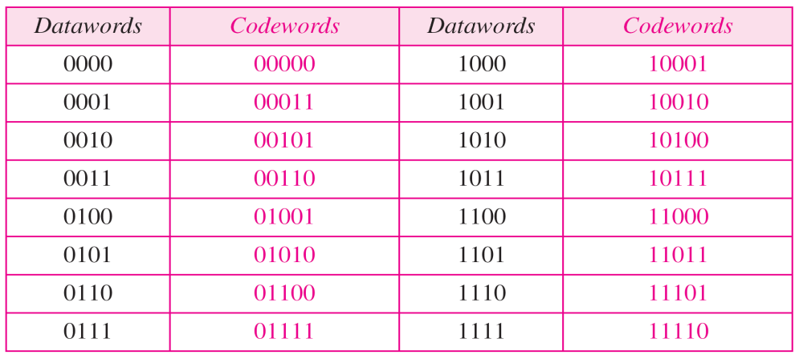
Table 10.3 Simple parity-check code C(5, 4) with d_{min}=2
5th bit in the codewords is chosen such that total number of 1 is even.
Simple parity-check code C(3, 2) with d_{min}=2
Table 10.1
10.<number>

Slide 40

Figure 10.10 Encoder and decoder for simple parity-check code
r_{o}=a₃ ⊕ a₂ ⊕ a₁ ⊕ a₀
s_{o}=b₃ ⊕ b₂ ⊕ b₁ ⊕ b₀⊕ q₀
The syndrome is 0 when the number of 1s in the received codeword is even; otherwise, it is 1.
10.<number>

Slide 41
r_{o}=a₃ ⊕ a₂ ⊕ a₁ ⊕ a₀
s_{o}=b₃ ⊕ b₂ ⊕ b₁ ⊕ b₀⊕ q₀
The syndrome is passed to the decision logic analyzer.
If the syndrome is 0, there is no error in the received codeword; the data portion of the received codeword is accepted as the dataword.
If the syndrome is 1, the data portion of the received codeword is discarded. The dataword is not created.
10.<number>

Slide 42
Example 10.12
codeword
a₃a₂a₁a₀→1011
r₀=1⊕0⊕1 ⊕1=1
a₃a₂a₁a₀r₀→10111
Let us look at some transmission scenarios. Assume the sender sends the dataword 1011. The codeword created from this dataword is 10111, which is sent to the receiver. We examine five cases:
s_{o}=1 ⊕0 ⊕1 ⊕1 ⊕1=0
1. No error occurs; the received codeword is 10111. The
syndrome is 0. The dataword 1011 is created.
2. One single-bit error changes a₁ . The received
codeword is 10011. The syndrome is 1. No dataword
is created. s_{o}=1 ⊕0 ⊕0 ⊕1 ⊕1=1
3. One single-bit error changes r₀ . The received codeword
is 10110. The syndrome is 1. No dataword is created.
s_{o}=1 ⊕0 ⊕1 ⊕1 ⊕0=1
10.<number>

Slide 43
Example 10.12 (continued)
codeword
a₃a₂a₁a₀r₀→10111
4. An error changes r₀ and a second error changes a₃ .
The received codeword is 00110. The syndrome is 0.
The dataword 0011 is created at the receiver. Note that
here the dataword is wrongly created due to the
syndrome value.
5. Three bits—a₃, a₂, and a₁—are changed by errors.
The received codeword is 01011. The syndrome is 1.
The dataword is not created. This shows that the simple
parity check, guaranteed to detect one single error, can
also find any odd number of errors.
10.<number>

Slide 44
Note
A simple parity-check code can detect an odd number of errors.
10.<number>

Slide 45

Figure 10.11 Two-dimensional parity-check code
A better approach is the two-dimensional parity check. In this method, the dataword is organized in a table (rows and columns).
In Figure 10.11, the data to be sent, five 7-bit bytes, are put in separate rows. For each row and each column, 1 parity-check bit is calculated.
The whole table is sent to the receiver, which finds the syndrome for each row and each column.
10.<number>

Slide 46

Figure 10.11 Two-dimensional parity-check code
the two-dimensional parity check can detect up to three errors that occur anywhere in the table (arrows point to the locations of the created nonzero syndromes).
10.<number>

Slide 47

Figure 10.11 Two-dimensional parity-check code
Errors affecting 4 bits may not be detected.
10.<number>

Slide 48
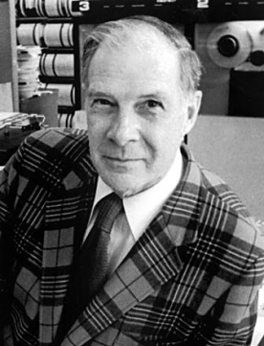
Richard Hamming, the inventor of Hamming codes, worked at Bell Labs in the late 1940s on the Bell Model V computer, an electromechanical relay-based machine. During weekdays, when errors in the relays were detected, the machine would stop and flash lights so that the operators could correct the problem. During after-hours periods and on weekends, when there were no operators, the machine simply moved on to the next job. In a taped interview, Hamming said, "And so I said, 'Damn it, if the machine can detect an error, why can't it locate the position of the error and correct it?'". Over the next few years, he worked on the problem of error-correction, developing an increasingly powerful array of algorithms. In 1950, he published what is now known as Hamming code.
Richard Wesley Hamming (February 11, 1915 – January 7, 1998) was an American mathematician whose work had many implications for computer engineering and telecommunications.
R. W. Hamming
10.<number>
[Ref.] https://en.wikipedia.org/wiki/Hamming_code

Slide 49
Error correcting code:
Hamming codes
Note
All Hamming codes discussed in this book have d_{min} = 3, which means that they can detect up to two errors or correct one single error.
We need to choose an integer m >= 3.
The values of n and k are then calculated from m as n = 2^{m}-1 and k= n - m.
The number of check bits or parity bits r = m.
For example, if m =3, then n= 7 and k= 4. This is a Hamming code C(7, 4) with d_{min} =3.
Table 10.4 shows the datawords and codewords for this code.
10.<number>

Slide 50
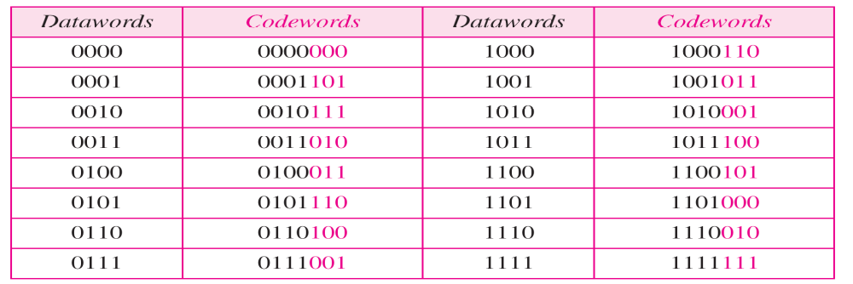
Table 10.4 Hamming code C(7, 4)
A copy of a 4-bit dataword is fed into the generator that creates three parity checks r_{o}, r₁ and r₂ as shown below:
r₀= a₂ ⊕ a₁ ⊕ a₀ r₁= a₃ ⊕ a₂ ⊕ a₁ r₂= a₁ ⊕ a₀ ⊕ a₃
The total number of 1s in each 4-bit combination (3 dataword bits and 1 parity bit) must be even.
any three equations that involve 3 of the 4 bits in the dataword and create independent equations (a combination of two cannot create the third) are valid.
10.<number>

Slide 51
a₃ | a₂ | a₁ | a₀ | r₂ | r₁ | r₀
0 | 1 | 0 | 1 | 1 | 1 | 0
The total number of 1s in each 4-bit combination must be even.
Independent equations are valid, i.e., a combination of two cannot create the third
r₀= a₂ ⊕ a₁ ⊕ a₀ = 1 ⊕ 0 ⊕ 1 = 0
r₁= a₃ ⊕ a₂ ⊕ a₁ = 0 ⊕ 1 ⊕ 0 = 1
r₂= a₁ ⊕ a₀ ⊕ a₃ = 0 ⊕ 1 ⊕ 0 = 1
r₀ ⊕r₁ = a₂ ⊕ a₁ ⊕ a₀ ⊕ a₃ ⊕ a₂ ⊕ a₁=a₀ ⊕ a₃
r₂= a₁ ⊕ a₀ ⊕ a₃
So, r₀ ⊕ r₁≠ r₂
10.<number>

Slide 52

Figure 10.12 The structure of the encoder and decoder for a Hamming code
s₂= b₁ ⊕ b₀ ⊕ b₃ ⊕ q₂
s₁= b₃ ⊕ b₂ ⊕ b₁ ⊕ q₁
s₀= b₂ ⊕ b₁ ⊕ b₀ ⊕ q₀
r₂= a₁ ⊕ a₀ ⊕ a₃
r₁= a₃ ⊕ a₂ ⊕ a₁
r₀= a₂ ⊕ a₁ ⊕ a₀
The equations used by the checker are the same as those used by the generator with the parity-check bits added to the right-hand side of the equation.
10.<number>

Slide 53


Table 10.5 Logical decision made by the correction logic analyzer
s₂= b₁ ⊕ b₀ ⊕ b₃ ⊕ q₂
s₁= b₃ ⊕ b₂ ⊕ b₁ ⊕ q₁
s₀= b₂ ⊕ b₁ ⊕ b₀ ⊕ q₀
(1)
 | s₂ | s₁ | s₀
q₀ | 0 | 0 | 1
q₁ | 0 | 1 | 0
q₂ | 1 | 0 | 0
b₃ | 1 | 1 | 0
b₂ | 0 | 1 | 1
b₁ | 1 | 1 | 1
b₀ | 1 | 0 | 1
(2)
(3)
Syndrome bit 0 means no error.
Now look closely at each of the above equations (1,2,3) and carefully watch the following scenario:
q₀ bit is in error => s₀ is affected
q₁ bit is in error => s₁ is affected
q₂ bit is in error => s₂ is affected
b₃ bit is in error => both s₂ and s₁ are affected
b₂ bit is in error => both s₁ and s₀ are affected
b₁ bit is in error => s₂, s₁ and s₀ are all affected
b₀ bit is in error => both s₂ and s₀ are affected
10.<number>

Slide 54
Table 10.5 Logical decision made by the correction logic analyzer
The 3-bit syndrome creates eight different bit patterns (000 to 111) that can represent eight different conditions.
These conditions define a lack of error or an error in 1 of the 7 bits of the received codeword, as shown in Table 10.5
The generator is not concerned with the four cases shaded in Table 10.5 because there is either no error or an error in the parity bit. In the other four cases, 1 of the bits must be flipped (changed from 0 to 1 or 1 to 0) to find the correct dataword.
The syndrome values in Table 10.5 are based on the syndrome bit calculations.
For example, if q_{o} is in error, s₀ is the only bit affected; the syndrome, therefore, is 001.
If b₂ is in error, s₀ and s₁ are the bits affected; the syndrome, therefore is 011.
Similarly, if b₁ is in error, all 3 syndrome bits are affected and the syndrome is 111
10.<number>

Slide 55
Example 10.13
b₃
b₂
b₁
b₀
q₂ q₁ q₀
0 1 0 0 0 1 1
Let us trace the path of three datawords from the sender to the destination:
The dataword 0100 becomes the codeword 0100011. The codeword 0100011 is received. The syndrome is 000, the final dataword is 0100.
s₂= b₁ ⊕ b₀ ⊕ b₃ ⊕ q₂ =0 ⊕0 ⊕0 ⊕0=0, s₁= b₃ ⊕ b₂ ⊕ b₁ ⊕ q₁ =0 ⊕1 ⊕0 ⊕1=0, s₀= b₂ ⊕ b₁ ⊕ b₀ ⊕ q₀= 1 ⊕ 0 ⊕ 0 ⊕ 1=0
2. The dataword 0111 becomes the codeword 0111001.The codeword 0011001 is received. The syndrome is 011. After flipping b₂ (changing the 0 to 1), the final dataword is 0111.
3. The dataword 1101 becomes the codeword 1101000.The codeword 0001000 is received. The syndrome is 101. After flipping b₀, we get 0000, the wrong dataword. This shows that our code cannot correct two errors.
Recall, d_{min}=3=2t+1, so t=1
10.<number>

Slide 56
Example 10.14
Note: the datawords in table 10.4 are 4 bits long
We need a dataword of at least 7 bits. Calculate values of k and n that satisfy this requirement.
n = 2^{m}-1
Solution
We need to make k = n − m greater than or equal to 7, or 2^{m} − 1-m ≥ 7.
1. If we set m = 3, the result is 2³ − 1-3 = 4 which is not acceptable. Here, n= 2³ − 1=7 and k = 7 − 3=4.
2. If we set m = 4, then 2⁴ − 1- 4 = 11 which satisfies the condition and hence acceptable. Here, n=2⁴ − 1=15 and k = 15 − 4 =11.
m=r parity check bits
C(15, 11)
There are methods to make the dataword a specific size, but the discussion and implementation are beyond the scope of this book.
10.<number>

Slide 57

Figure 10.13 Burst error correction using Hamming code
10.<number>

Slide 58
Burst error correction using Hamming code
The key is to split a burst error between several codewords, one error for each codeword.
In data communications, we normally send a packet or a frame of data.
To make the Hamming code respond to a burst error of size N, we need to make N codewords out of our frame.
Then, instead of sending one codeword at a time, we arrange the codewords in a table and send the bits in the table a column at a time.
In Figure 10.13, the bits are sent column by column (from the left). In each column, the bits are sent from the bottom to the top.
In this way, a frame is made out of the four codewords and sent to the receiver.
In Figure 10.13, when a burst error of size 4 corrupts the frame, only 1 bit from each codeword is corrupted. The corrupted bit in each codeword can then easily be corrected at the receiver.
10.<number>

Slide 59
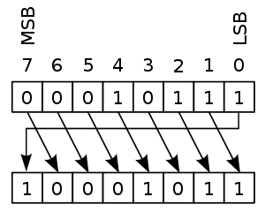
10-4 CYCLIC CODES
Cyclic codes are special linear block codes with one extra property. In a cyclic code, if a codeword is cyclically shifted (rotated), the result is another codeword.
If 00010111 is a valid codeword, applying a right circular shift gives the string 10001011. If the code is cyclic, then 10001011 is again a valid codeword.
[Ref.] https://en.wikipedia.org/wiki/Cyclic_code
10.<number>

Slide 60

Table 10.6 A CRC code with C(7, 4)
Cyclic Redundancy Check (CRC)
The cyclic redundancy check (CRC) is a category of cyclic codes that is used in networks such as LANs and WANs. This is an error-detecting code. Table 10.6 shows an example of a CRC code. We can see both the linear and cyclic properties of this code.
10.<number>

Slide 61
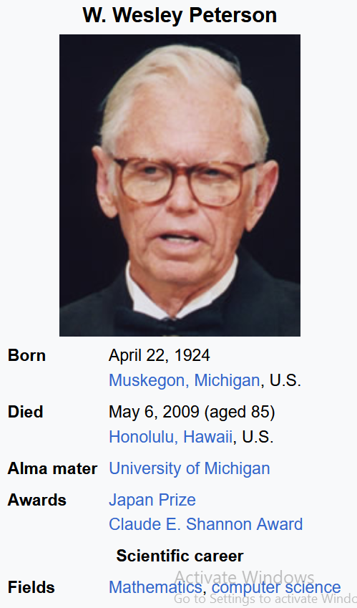

William Wesley Peterson (April 22, 1924 – May 6, 2009) was an American mathematician and computer scientist. He was best known for designing the cyclic redundancy check (CRC), for which research he was awarded the Japan Prize in 1999.
https://en.wikipedia.org/wiki/W._Wesley_Peterson
Japan prize: ≈ 4,00,00,000.00 BDT
Nobel prize: ≈ 10,00,00,000.00 BDT
10.<number>

Slide 62
Linear property checked
1011
1100
0111
1011000 ⊕1100010 = 0111010
1011
1 | 0 | 1 | 1 | 0 | 0 | 0
0 | 1 | 0 | 1 | 1 | 0 | 0
0101
Circular property checked
10.<number>

Slide 63
CRC encoder and decoder
In the encoder, the dataword has k bits (4 here); the codeword has n bits (7 here).
The size of the dataword is augmented by adding n - k (3 here) 0s to the right-hand side of the word.
The n-bit result is fed into the generator. The generator uses a divisor of size n - k + 1 (4 here), redefined and agreed upon.
The generator divides the augmented dataword by the divisor (modulo-2 division).
The quotient of the division is discarded; the remainder (r₂r₁r₀) is appended to the dataword to create the codeword.
10.<number>

Slide 64
CRC encoder and decoder
The decoder receives the possibly corrupted codeword.
A copy of all n bits is fed to the checker which is a replica of the generator.
The remainder produced by the checker is a syndrome of n - k (3 here) bits, which is fed to the decision logic analyzer. The analyzer has a simple function.
If the syndrome bits are all 0s, the 4 leftmost bits of the codeword are accepted as the dataword (interpreted as no error); otherwise, the 4 bits
are discarded (error).
10.<number>

Slide 65

Figure 10.14 CRC encoder and decoder
k=4, n=7
n-k=7-4=3
n-k=3
n-k+1=3+1=4
10.<number>

Slide 66

Figure 10.15 Division in CRC encoder
The encoder takes the dataword and augments it with n - k number of 0s. It then divides the augmented dataword by the divisor, as
shown in Figure 10.15
10.<number>

Slide 67

Figure 10.16 Division in the CRC decoder for two cases
10.<number>

Slide 68

Figure 10.21 A polynomial to represent a binary word
10.<number>

Slide 69

Figure 10.22 CRC division using polynomials
1001=x³+0x²+0x¹+1x⁰=x³+1
1011=x³+0x²+1x¹+1x⁰=x³+x+1
1001000=x⁶+0x⁵+0x⁴+1x³+0x²+0x¹+0x⁰
=x⁶+x³
110
1001110
10.<number>

Slide 70
The divisor in a cyclic code is normally called the generator polynomial or simply the generator.
Name | Uses | Generator Polynomials
CRC-6-GSM | mobile networks | x⁶+x⁵+x³+x²+x+1
CRC-8-Bluetooth | wireless connectivity | x⁸+x⁷+x⁵+x²+x+1
CRC-30 | CDMA | x³⁰+x²⁹+x²¹+x²⁰+x¹⁵+x¹³+x¹²+x¹¹+x⁸+x⁷+x⁶+x²+x+1
CRC-32 | LANs | x³²+x²⁶+x²³+x²²+x¹⁶+x¹²+x¹¹+x¹⁰+x⁸+x⁷+x⁵+x⁴+x²+x+1
Ref. https://en.wikipedia.org/wiki/Cyclic_redundancy_check
10.<number>

Slide 71
CRC can detect a burst error
❏ All burst errors with L ≤ r will be detected.
❏ All burst errors with L = r + 1 will be detected with probability 1 – (1/2)^{r–1}.
❏ All burst errors with L > r + 1 will be detected with probability 1 – (1/2)^{r}.
Example: Find the suitability of the following generator in relation to burst errors of different lengths: x⁶ + 1.
Solution:
This generator can detect all burst errors with a length less than or equal to 6 bits.
i.e., For L ≤ 6: Detection probability =100
For L=7: Detection probability =1-(0.5)⁶⁻¹ = 1-(0.5)⁵ = 1- 0.03125 = 0.968≈97%
For L=8: Detection probability =1-(0.5)⁶ = 1-(0.5)⁶ = 1- 0.015625 = 0.984 ≈98%
10.<number>

Slide 72
Home Work
Problem 1: A bit stream 1101011011 is transmitted using the standard CRC method. The generator polynomial is x⁴+x+1. What is the actual bit string transmitted?
Ans: 11010110111110.
Problem 2: A bit stream 10011101 is transmitted using the standard CRC method. The generator polynomial is x³+1. (i) what is the actual bit string transmitted? (ii) suppose the third bit from the left is inverted during transmission. How will receiver detect this error?
Ans: (i) = 10011101100.
10.<number>

